Slide 1

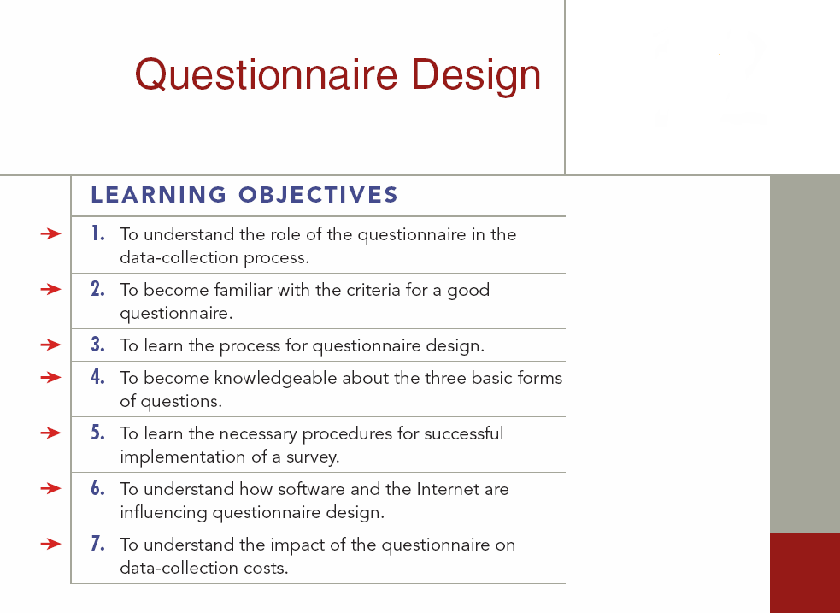
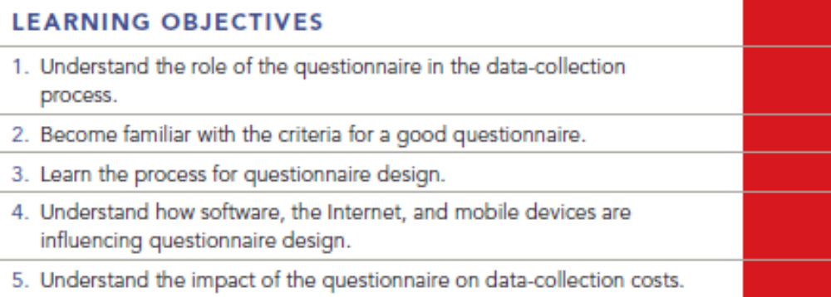
Chapter Twelve Q & A
12-1

Slide 2
Question
What’s wrong with the following questions?
How do you like the flavor of this high-quality Maxwell House coffee?
b. What do you think of the taste and texture of this Sara Lee coffee cake?
c. We are conducting a study for Bulova watches. What do you think of the quality of Bulova watches?

Slide 3
Answer
a. How do you like the flavor of this high-quality Maxwell House coffee? bias - leading question
b. What do you think of the taste and texture of this Sara Lee coffee cake? Double-Barreled questions
c. We are conducting a study for Bulova watches. What do you think of the quality of Bulova watches? Client introduced - bias

Slide 4
Question
Give examples of poor questionnaire wording and explain what is wrong with each question.

Slide 5
Answer
“Have you recently tried and enjoyed the new Burger King Big King sandwich?” Double questions and is leading (biased).
“Many people have recently watched the movie, Titanic. Have you seen it?” Leading to bias
“How satisfied were you with the all new and improved Clean-O laundry detergent?” Introduced bias.
“How many days do you sleep until 8:00 a.m.?” Vague.

Slide 6
Question
Design three open-ended and three closed-ended questions to measure consumers’ attitudes toward BMW automobiles.

Slide 7
Answer
Open-ended:
How comfortable is the driver’s seat in the BMW?
What is your opinion of the body style of the two-door coupe?
What did you think of the sound system in the BMW?
Closed-ended:
1.What exterior color do you like most of those offered by BMW?
Forest Green White Navy Burgundy Taupe
2.How would you judge the quality of the ride in the BMW?
Very smooth Somewhat smooth No Opinion Somewhat bumpy Very bumpy

Slide 8
Answer(Cont’d)
Closed-ended:
Please rank the following features (with 1 being the most important and 8 being the least important) in their importance to you in buying a new car.
Gas Mileage Automatic Transmission
Body style Special feature (power doors, windows, etc.)
Sound system Acceleration speed
Interior color Exterior color

Slide 9
Question
Which of the following would not be a good practice regarding question sequencing?
general questions at the end
general questions at the beginning
sensitive questions at the end
questions requiring work in the middle
none of these

Slide 10
Answer
Ans: A

Slide 11
Question
What type of question is the following?
Which of the following age categories best describes your age?
____0-18 ____19-24 ____25-34 ____35 and over
dichotomous question
open-ended question
multiple choice question
scaled question
none of these

Slide 12
Answer
Ans: C

